Slide 1
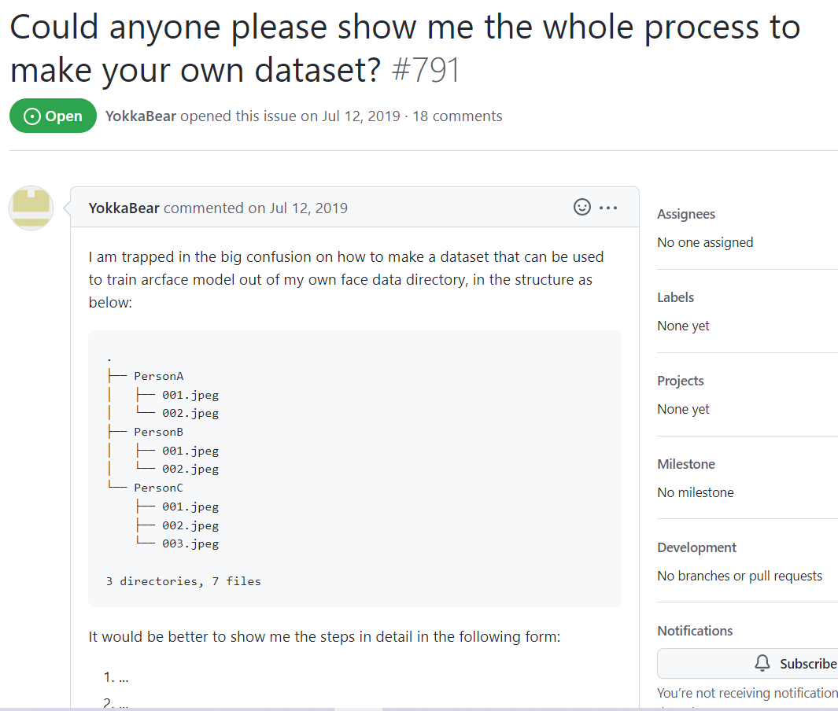

Slide 2
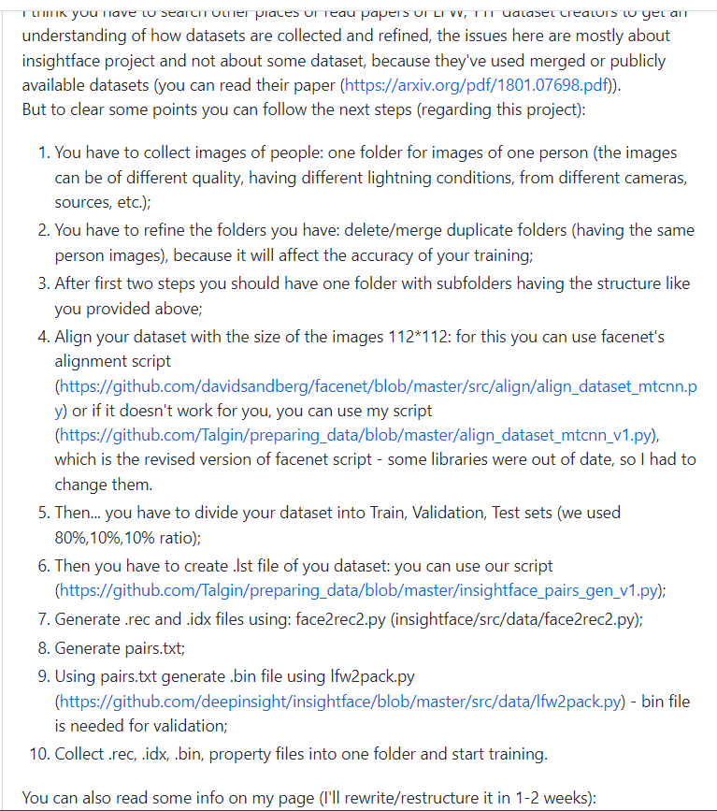
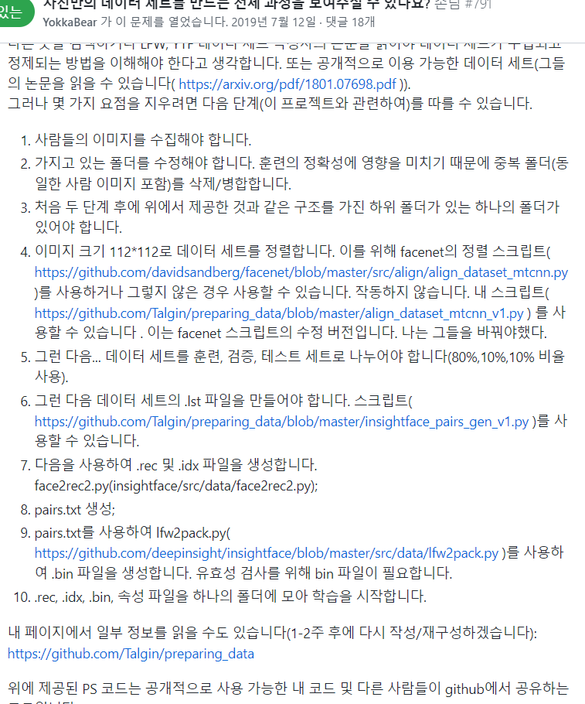

Slide 3
def get_frames(self, save_folder, videos): #영상프레임을 사진데이터로 저장 #print("extract",video_file) for video in videos: vdo = cv2.VideoCapture(video) print("vdo", vdo) # frame_count, width, height, fps length, width, height, fps = int(vdo.get(7)), int(vdo.get(3)), int(vdo.get(4)), int(vdo.get(5)) print(f"length: {length}, w x h: {width} x {height}, fps: {fps}\n") frame_count = 0 while (vdo.isOpened()): ret, frame = vdo.read() if not ret: print("비디오 읽기 오류") vdo.release() cv2.destroyAllWindows() break if frame_count < 50 * 5: if frame_count % 5 == 0: cv2.imshow('video', frame) fullimg = os.path.basename(video).replace(".", "_") + "_" + str(frame_count) + ".png" # IU.avi IU_avi_11.png fullimg = os.path.join(save_folder, fullimg) # C:\Users\USER\Desktop\Facedlib\MakeData\Data\Face_images\IU \ IU_avi_11.png print("imgfile", fullimg) #frame = cv2.cvtColor(frame, cv2.COLOR_BGR2RGB) cv2.imwrite(fullimg, frame) frame_count += 1 else: frame_count += 1 continue if cv2.waitKey(5) == 27: # ESC key press break if vdo.get(cv2.CAP_PROP_POS_FRAMES) == vdo.get(cv2.CAP_PROP_FRAME_COUNT): break
1.사람 이미지 프레임 수집

Slide 4
def extract_faces(self, save_folder): #사진에서 얼굴만 추출 pp=os.path.join(CROPPED_IMAGE_FOLDER,save_folder.split('\\')[-1]) #C: \ Users \ USER \ Desktop\Facedlib\MakeData\Data\ Cropped_images \ IU os.makedirs(pp, exist_ok=True) print("extract_Faces",pp) folders = list(glob.iglob(os.path.join(save_folder, '*.*'))) print("extract_Faces",folders) for img_path in folders: resp = RetinaFace.extract_faces(img_path=img_path, align=True) for img in resp: img = cv2.resize(img, (112,112)) print(img.shape) img = cv2.cvtColor(img, cv2.COLOR_BGR2RGB) cv2.imwrite(pp+"\\"+img_path.split("\\")[-1], img) print(save_folder.split('\\')[-1],"완료")
2.사람 얼굴만 이미지로.
4.이미지를 112,112로 정리
def main(extractor): folders = list(glob.iglob(os.path.join(VIDEOS_FOLDER, '*'))) #경로 뭉탱이를 리스트로 names = [os.path.basename(folder) for folder in folders] # only name for i, folder in enumerate(folders): name = names[i] videos = list(glob.iglob(os.path.join(folder, '*.*'))) print('1', videos) save_folder = os.path.join(FACE_IMAGES_FOLDER, name) print(save_folder) os.makedirs(save_folder, exist_ok=True) #for video in videos: print("videoname",videos) extractor.get_frames(save_folder, videos) crop_save_folder = os.path.join(FACE_IMAGES_FOLDER, name) extractor.extract_faces(crop_save_folder)

Slide 5
#rec,idx파일 만들어짐
from insightface.data.rec_builder import RecBuilder
import matplotlib.pyplot as plt
import glob
import cv2
import os
FOLDER = "/content/drive/MyDrive/Colab Notebooks/files/downloaded_images"
folders = list(glob.iglob(os.path.join(FOLDER, '*'))) #경로 뭉탱이를 리스트로
names = [os.path.basename(folder) for folder in folders] # only name
rec = RecBuilder("/content/new")
count=0
for i, folder in enumerate(folders):
name = names[i]
images = list(glob.iglob(os.path.join(folder, '*.*')))
print("imgs",len(images))
count+=len(images)
for img_path in images:
img = cv2.imread(img_path)
print("shapes",img.shape)
img = cv2.cvtColor(img, cv2.COLOR_BGR2RGB)
rec.add_image(img, i)
print(name,"finished")
print(count)
7.rec,idx파일 생성
9.bin파일 만드는법 - https://mxnet.apache.org/versions/1.9.1/api/faq/recordio
https://mxnet.apache.org/versions/1.7/api/python/docs/api/mxnet/recordio/index.html

Slide 6
6,7. Mxnet 이용해서 im2rec파일로 lst, rec, idx파일 동시에 만들기(보완필요)
/usr/local/lib/python3.8/dist-packages/Mxnet/tool/im2rec.py
코랩에서 mxnet설치 후 im2rec.py위치
깃허브 참조 - https://github.com/leocvml/mxnet-im2rec_tutorial
#https://github.com/deepinsight/insightface/tree/master/recognition/arcface_torch
#만들어지나 내용이 없음??
#create lst,rec,idx file in Face_images file
%cd /content/drive/MyDrive/Colab Notebooks/files/Cropped_images
!pwd
#!python -m mxnet.tools.im2rec --list --recursive train Cropped_images
!python -m mxnet.tools.im2rec --num-thread 16 --quality 100 train Cropped_images
https://colab.research.google.com/drive/1e-bEx5vD3U9fgGlGY7Xj5fuXmLXhTkgW?usp=sharing
여기까지 준비한 것으로 학습은 되나 검증데이터파일이 없어서 학습이 끝나지 않음
Insightface에서 제공하는 가장 작은 데이터로 학교 컴퓨터로 학습시키면 4-5일정도 소요될 것으로 예상

